Slide 1

Cloud Based Home Automation System
Under- Mr. Gaurav Saxena Sir
By-
Group No-45
Ayush Dhakad (181B060)
Garvit Chugh (181B090)
Rishabh Verma (181B167)

Slide 2

Contents:
Introductions
Descriptive Study
Circuit Diagram
Detailed Work
Applications

Slide 3

Introduction:
Problem:
The increasing consumption of energy and population, there is an urgent need to conserve energy in every possible way.
The inability to access and control the electronics and electrical appliances remotely from any location is one of the major reasons for energy loss.
Solution:
A web or an android application can be used by the users to give instructions to these systems and control the appliances remotely.
This system can make use of communication methods such as Internet, Wi-Fi, Bluetooth.

Slide 4

Descriptive Study:
The project structure is as :
1.Android Application : So, android applications is used for the control of the whole system . It is developed using Android Studio and connected with the firebase account. It has two login features to access.It consist of login and buttons (i.e. BULB and FAN) to control devices connected. Colour are given to the buttons(Green for ON, Red for OFF) which indicates the working of the devices whether it is ON or OFF .In further additional voice control is added in form of a mic button for giving voice command using the Google Assistants of the android device.
2. Python Shell : It is used for control and access .All devices and Node-MCU should be connected to same Wi-Fi Network. It’s helps in sending command to specific device through their IP Addresses in the network.
3. Hardware : It is the setup of the NodeMCU and relay switch with device connected which needed to operated for demonstration using the android application (firebase). The ino code is runned on Arduino ide for IP address of NodeMCU.
NOTE: All the system is just a prototype module of how a system works and hence it could be extended.

Slide 5


Detailed Work:
Arduino Program :
ino code is used to track the IP address of the Node MCU for the python shell script to work along with it .
pmw function is used to track the digital signals in order to control devices and applications requiring power. Serial is used to get the IP address .
At last ,ino program display the address in term of float string.

Slide 6
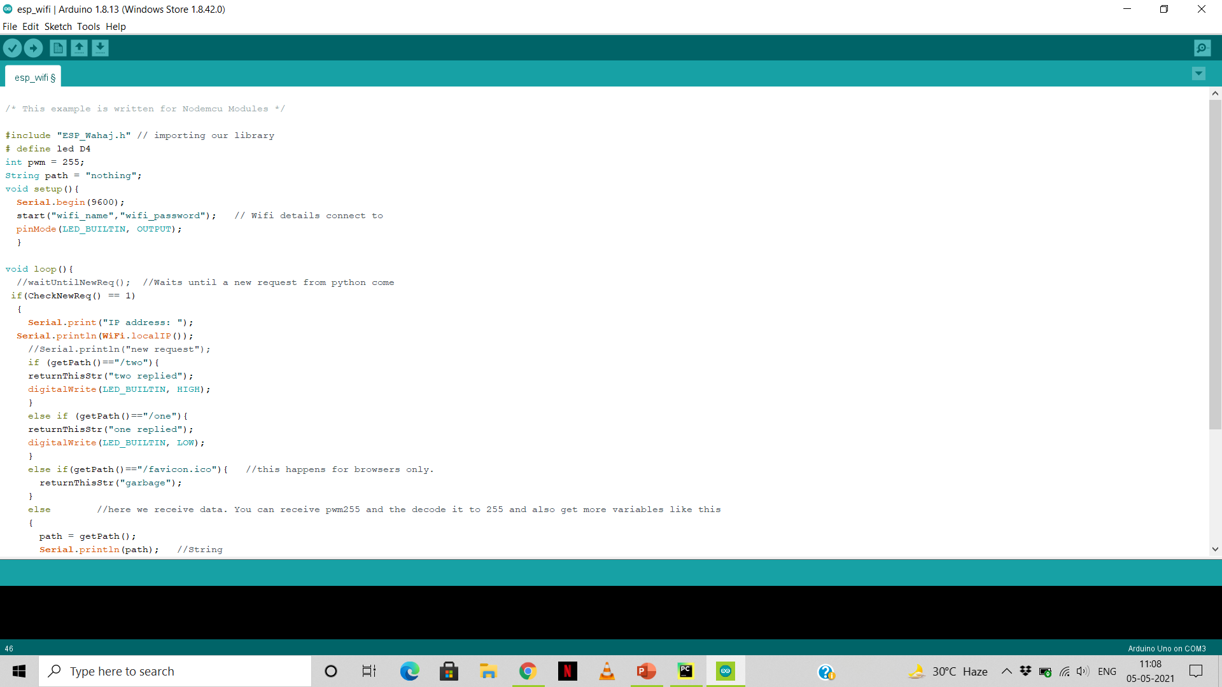

Slide 7
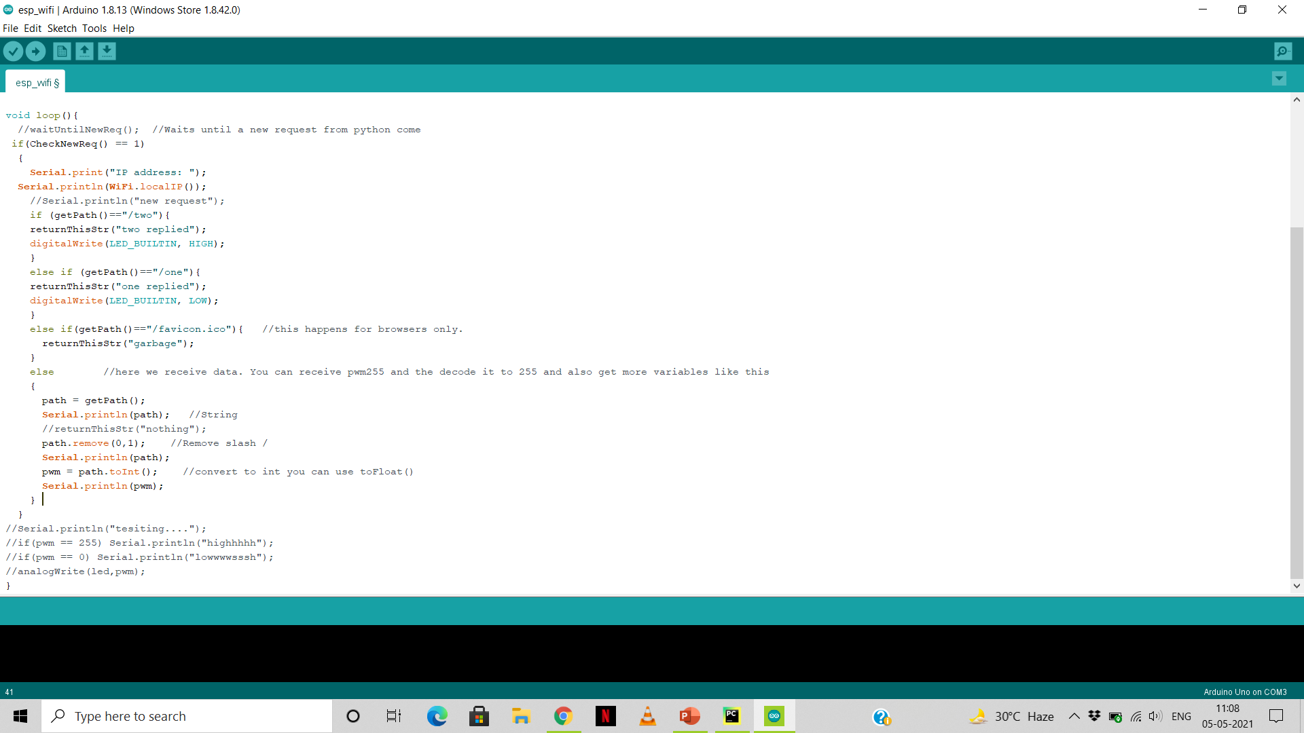

Slide 8

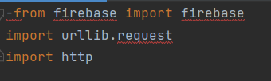
Python shell :
urllib.request : Urllib module is the URL handling module for python. It is used to fetch URLs (Uniform Resource Locators). It uses the urlopen function and is able to fetch URLs using a variety of different protocols.
Firebase url is being used in the code as import function which deals and stable a connection between the android application and python shell .
At last, transfer function followed by the bulb and fan function which allow to operate devices as per the user requirements.

Slide 9
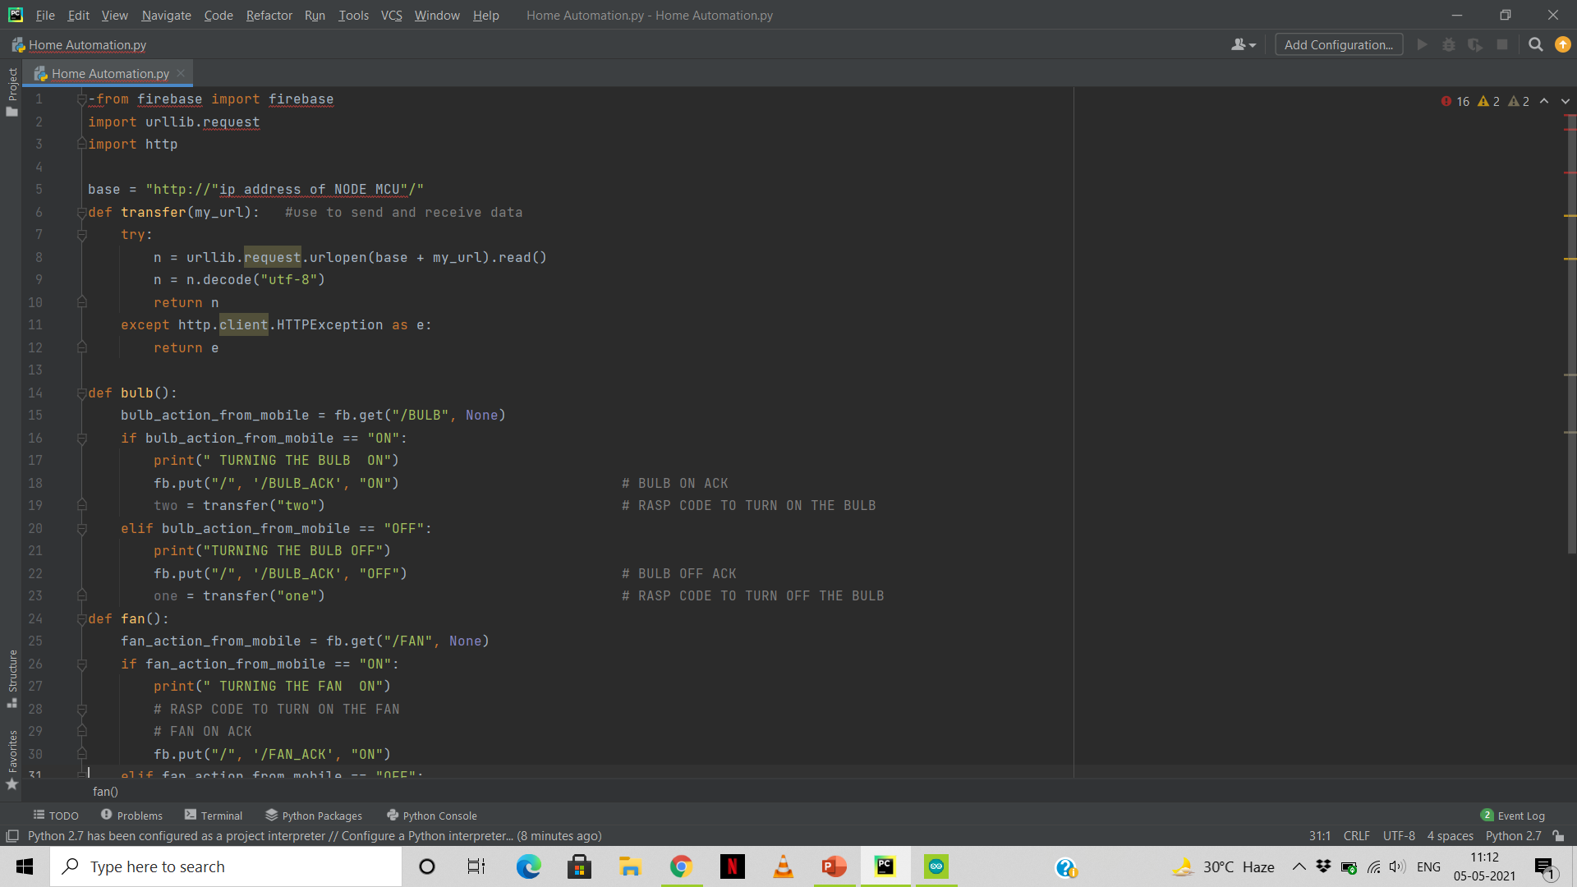

Slide 10
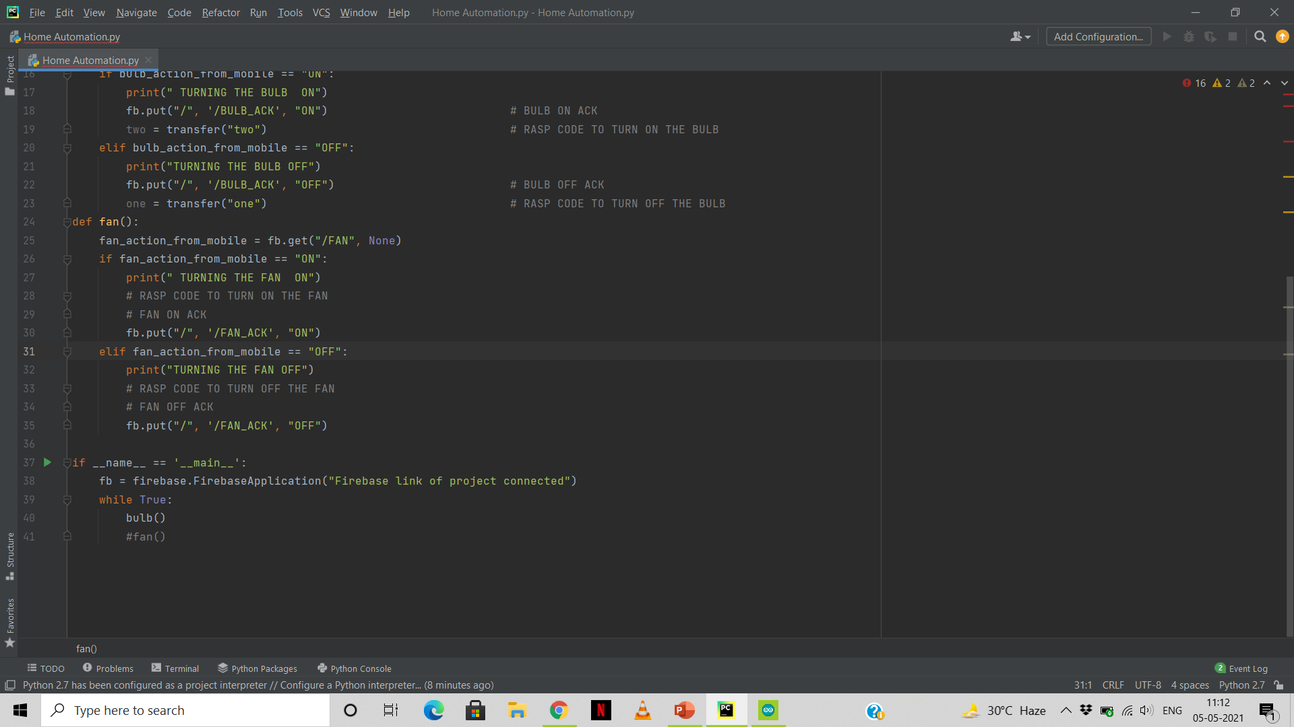

Slide 11
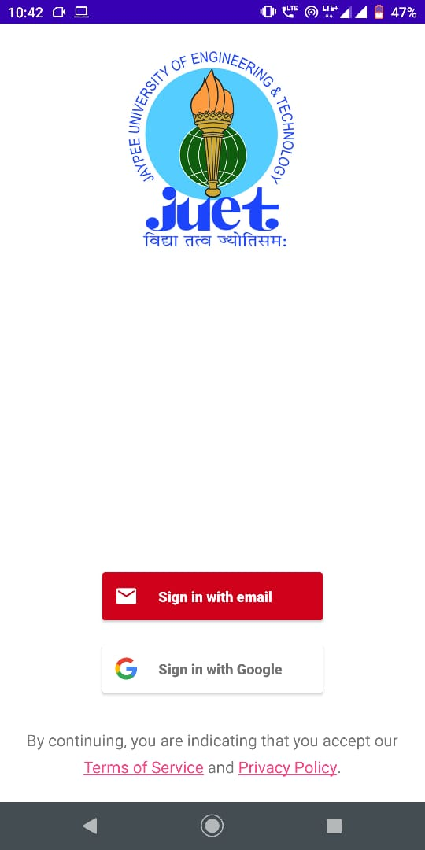
Android Application:
It user design consist of button according to the appliances connected to the system which function to turn ON and turn OFF having colour green indicating ON and red indicating OFF.
One can access the system and working of the applications using mobile number or the google accounts credentials.
It consist of two login options one is with google account and other is with random email .(next can be using a mobile number)
Fig: Design of Application (open screen)

Slide 12
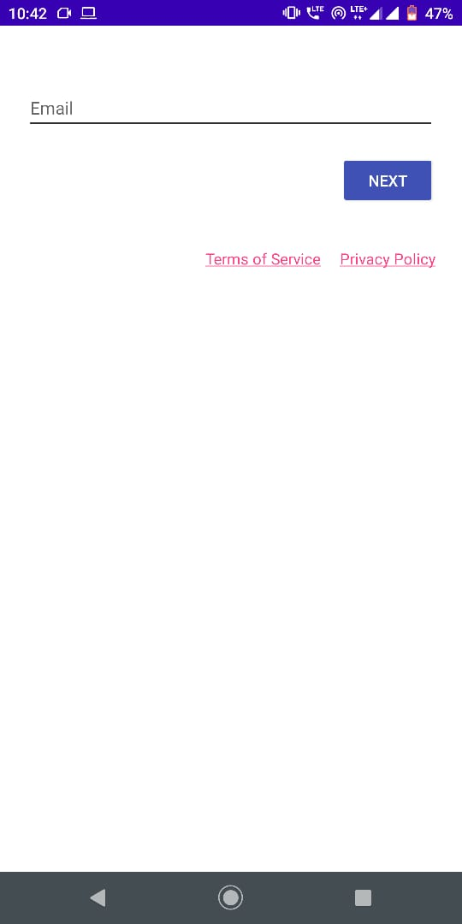
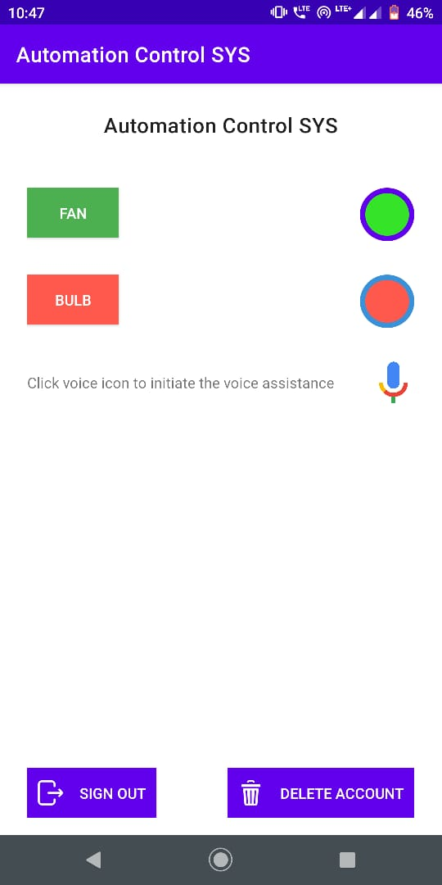
Fig: Login using email id
Fig: control screen for devices

Slide 13


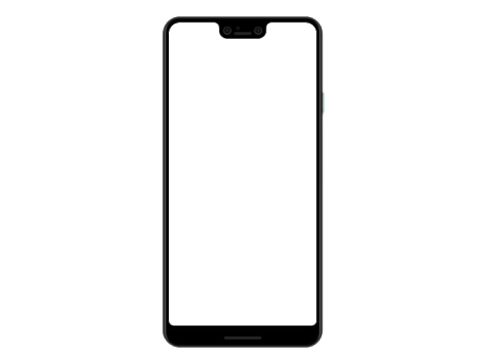





Circuit Diagram:
Internet (Firebase)
System with Wi-Fi
Device with Wi-Fi
Android Application
Hotspot/Router with Internet
Home System

Slide 14

Applications:
System can be available in very less cost to rural area peoples and schools.
Reducing more complexity of things and easily available to people.
Increasing security of the system.
It can be expanded for energy monitoring, or weather stations.
This kind of a system with respective changes can be implemented in the hospitals for disable people or in industries where human invasion is impossible or dangerous, and it can also be implemented for environmental monitoring.

Slide 15
Thank You!!!

